Slide 1
Automating Data Import and Relationship Mapping Using Import Sets & Dot Walking

Slide 2
Team Assignments
Team Member | Role & Assignment
Al Jazeera K (Team Lead) | Project oversight, Create records in the Sheet, Conclusion
Karthika S | Creating Import Table (Staging), Match fields using Mapping Assist
Hajira Banu M | Create Transform Map Configuration
Naveen Kumar S | Transform the Data, Result validation (Testing)

Slide 3
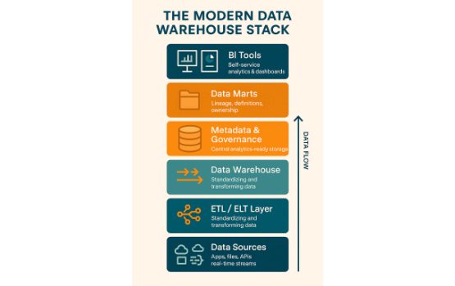
Executive Summary
•
Streamlined onboarding and updates of employee records within ServiceNow via automated data ingestion.
•
Utilized native Import Sets and Transform Maps to transfer external spreadsheet data securely.
•
Integrated directly into the core sys_user table, maintaining critical data architecture.
•
Enhanced IT Service Desk operational efficiency by implementing dot-walking on the Incident form.
•
Significantly reduced manual data entry errors and provided immediate visibility into user context during incidents.

Slide 4
Key User Pain Points
Administrators: Wasting substantial administrative time manually inputting hundreds of employee records during onboarding cycles.
Service Desk Agents: Experiencing inefficiency caused by constantly switching tabs away from the Incident form to look up an Assigned User's details.
Data Integrity: Compromising database health with duplicate user records created due to a lack of automated coalescing and matching checks.

Slide 5

Understanding Empathy
Before deployment, IT Support Agents and System Administrators faced immense friction. The daily operations were hampered by tedious manual entry and navigation overhead.
By mapping out the thoughts, feelings, and actions of these critical users, we identified that the core frustration was the disconnection between data entry systems and active incident resolution workspaces.

Slide 6
Implementation Workflow
2. Stage & Load
4. UI Config
Utilize System Import Sets to create the staging table u_import_employee.
Apply Form Design to dot-walk user context to Incident workspace.
1. Data Prep
3. Transform Map
Format Google Sheet data and export locally as CSV/XLSX file.
Map identical fields and set email to coalesce targeting sys_user.

Slide 7



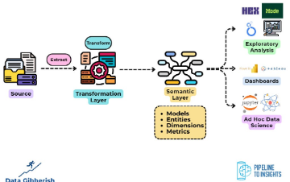

Core Implementation Phases
Data Loading
Transformation
Dot-Walking UI
Securely staging spreadsheet data into a temporary import set table.
Mapping fields and establishing coalesce rules to maintain integrity.
Configuring the Incident form to dynamically pull related profile details.

